Slide 1
ON-SITE GREENHOUSE
WE SOURCE INGREDIENTS FROM OUR ON-SITE GREENHOUSE.
At Paramount Events, our green-forward initiatives start from the ground up. We uphold a steadfast commitment to sustainable, eco-friendly, and all organic practices by sourcing the bulk of our ingredients from local farms and purveyors.
SUSTAINABILITY
WE FOCUS ON SUSTAINABILITY & ARE GREEN-CERTIFIED.
Our sustainability efforts include composting on-site and at off-site events and locations; eliminated single-use plastic water bottles in our office; reducing our use and trying to move away from disposable packaging; and working with food donation organizations and companies to decrease food waste.

Slide 2
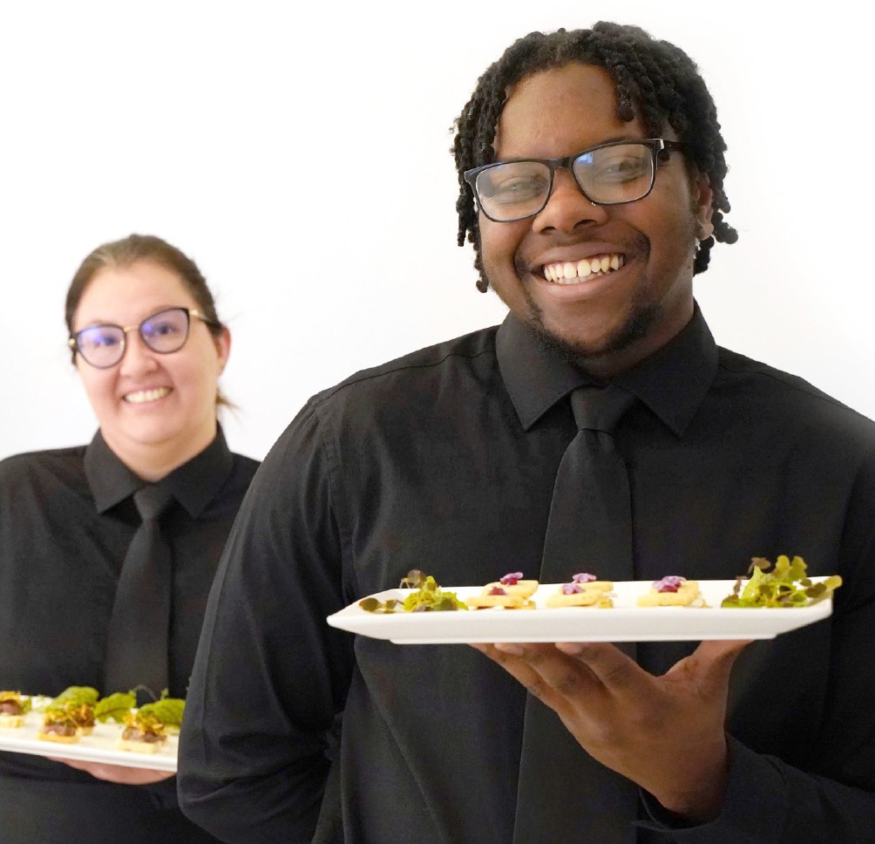
A FLAWLESS EXPERIENCE
WE UNDERSTAND THE IMPORTANCE OF PULLING OFF A FLAWLESS EXPERIENCE FOR YOU AND YOUR GUESTS.
No matter the guest count, venue, or reason for celebrating - our team shows up to make it happen.
HI, I’M CHLOE BRYNIARSKI!
This is subtext
CALL CHLOE BRYNIARSKI OR EMAIL CBRYNIARSKI@PARAMOUNTEVENTSCHICAGO.COM

Slide 3
AN OVERVIEW OF YOUR EVENT
CLIENT INFORMATION
Client Name Client Email
DATE
Event Date
VENUE INFORMATION
Name
Address
Chicago, Illinois 60611
SAMPLE TIMELINE
3:00pm | Paramount Events Team Arrives for Set-Up
6:00pm | Cocktail Reception Begins
 | Bars Open
 | Hors D’oeuvre Passing Begins
6:30pm | Hors D’oeuvre Stations Open
7:00pm | Hors D’oeuvre Passing Concludes
8:00pm | Event Concludes
9:00pm | Paramount Events Completes Breakdown
GUEST COUNT
600

